Slide 1
Composite Pattern
Structural and Collectional

Slide 2
Definition
Compose objects into tree structures to represent part-whole hierarchies.
Composite lets clients treat individual objects and compositions of objects uniformly.

Slide 3
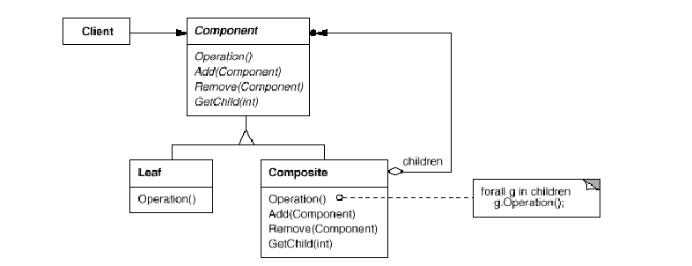
Structure

Slide 4
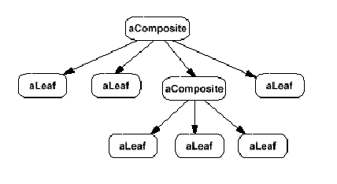
Object Structure

Slide 5
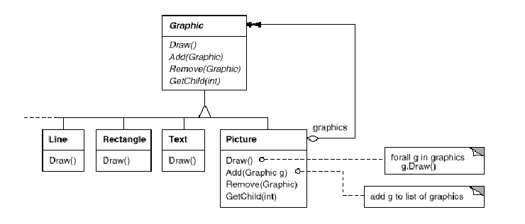
Motivation – Graphics Application

Slide 6
Without composite pattern
Code that uses these classes must treat
primitive and container objects differently,
even if most of the time the user treats
them identically.
Having to distinguish these objects
makes the application more complex.

Slide 7
Applying composite pattern
Describes how to use recursive composition so that clients don't have to make this distinction.

Slide 8
Applicability
Use the Composite pattern when
  you want to represent part-whole hierarchies of objects.
  you want clients to be able to ignore the difference between compositions of objects and individual objects.Clients will treat all objects in the composite structure uniformly.

Slide 9
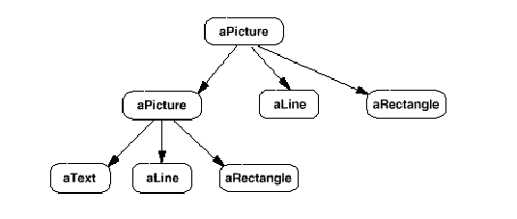
Composite object structure of recursively composed Graphic objects

Slide 10
Participants
Component (Graphic)
  declares the interface for objects in the composition.
  implements default behavior for the interface common to all classes, as appropriate.
  declares an interface for accessing and managing its child components.
  (optional) defines an interface for accessing a component's parent in the recursive structure, and implements it if that's appropriate.

Slide 11
Participants
Leaf (Rectangle, Line, Text, etc.)
  represents leaf objects in the composition. A leaf has no children.
  defines behavior for primitive objects in the composition.

Slide 12
Participants
Composite (Picture)
  defines behavior for components having children.
  stores child components.
  implements child-related operations in the Component interface.

Slide 13
Participants
Client
  manipulates objects in the composition through the Component interface.

Slide 14
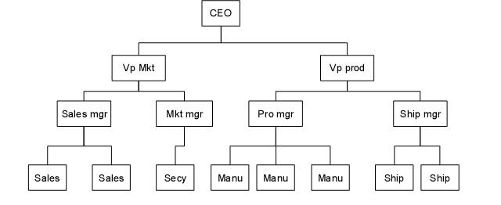
Cost of an employee in a company

Slide 15
Implementation of Composite
We define the cost as the salary of that person and those of all his subordinates.
Here is an ideal example for a composite:
  The cost of an individual employee is simply his salary (and benefits).
  The cost of an employee who heads a department is his salary plus those of all his subordinates.

Slide 16
Employee Class
public class Employee
{
String name;
float salary;
Vector subordinates;
//--------------------------------------
public Employee(String _name, float _salary) {
name = _name;
salary = _salary;
subordinates = new Vector();
}
//--------------------------------------
public float getSalary() {
return salary;
}
//--------------------------------------
public String getName() {
return name;
}

Slide 17
Employee Class
If you want to get a list of employees of a given supervisor, you
can obtain an Enumeration of them directly from the subordinates
Vector:
public Enumeration elements() {
return subordinates.elements();
}

Slide 18
Employee Class
The important part of the class is how it returns a sum of salaries
for the employee and his subordinates:
public float getSalaries() {
float sum = salary; //this one’s salary
//add in subordinates salaries
for(int i = 0; i < subordinates.size(); i++) {
sum +=
((Employee)subordinates.elementAt(i)).getSalaries();
return sum;
}
}

Slide 19
Building the Employee Tree
boss = new Employee("CEO", 200000);
boss.add(marketVP = new Employee("Marketing VP", 100000));
boss.add(prodVP = new Employee("Production VP", 100000));
marketVP.add(salesMgr = new Employee("Sales Mgr", 50000));
marketVP.add(advMgr = new Employee("Advt Mgr", 50000));
//add salesmen reporting to Sales Manager
for (int i=0; i<5; i++)
salesMgr .add(new Employee("Sales "+new Integer(i).toString(), 30000.0F+(float)(Math.random()-0.5)*10000));
advMgr.add(new Employee("Secy", 20000));

Slide 20
Consequences of Composite Pattern
The Composite pattern allows you to define a class hierarchy of simple objects and more complex composite objects so that they appear to be the same to the client program.
The Composite pattern also makes it easy for you to add new kinds of components to your collection.

Slide 21
Consequences of Composite Pattern
The composite is essentially a singly-linked tree, in which any of the objects may themselves be additional composites.
It is perfectly possible for any composite element to remember its parent by including it as part of the constructor:
public Employee(Employee _parent, String _name,float _salary)
{
name = _name; //save name
salary = _salary; //and salary
parent = _parent; //and parent
subordinates = new Vector();
isLeaf = false; //allow children
}

Slide 22
Issues to consider when implementing the Composite pattern
Explicit parent references.
  Maintaining references from child components to their parent can simplify the traversal and management of a composite structure.
  The usual place to define the parent reference is in the Component class.
Sharing components.
  It's often useful to share components, for example, to reduce storage requirements. But when a component can have no more than one parent, sharing components becomes difficult.

Slide 23
Issues to consider when implementing the Composite pattern
Maximizing the Component interface.
  One of the goals of the Composite pattern is to make clients unaware of the specific Leaf or Composite classes they're using.
  To attain this goal, the Component class should define as many common operations for Composite and Leaf classes as possible.
  The Component class usually provides default implementations for these operations, and Leaf and Composite subclasses will override them.

Slide 24
Issues to consider when implementing the Composite pattern
Declaring the child management operations.
  Although the Composite class implements the Add and Remove operations for managing children, an important issue in the Composite pattern is which classes declare these operations in the Composite class hierarchy.
  Should we declare these operations in the Component and make them meaningful for Leaf classes, or should we declare and define them only in Composite and its subclasses?

Slide 25
Issues to consider when implementing the Composite pattern
The decision involves a trade-off between safety and transparency:
  Defining the child management interface at the root of the class hierarchy gives you transparency, because you can treat all components uniformly. It costs you safety, however, because clients may try to do meaningless things like add and remove objects from leaves.
  Defining child management in the Composite class gives you safety, because any attempt to add or remove objects from leaves will be caught at compile-time in a statically typed language like C++. But you lose transparency, because leaves and composites have different interfaces.

